Slide 1
Data Strategy 2022-2024
Raphael Manuel

Slide 2
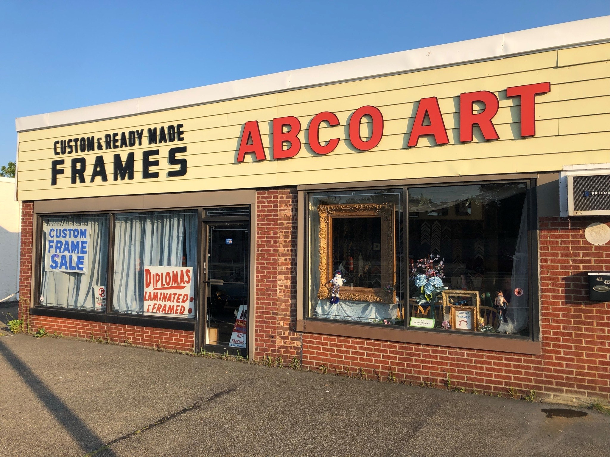

Slide 3
About The Business
Abco Art Inc. started off as a commercial graphic art studio and commercial sign business in 1945. It was then converted into an art supply and custom framing store in 1954.
Located on Sunrise Highway. One of the busiest roads on Long Island.
Thrived as a framing business writing hundred of orders everyday.
At its peak employed over two dozen workers.
Main vendors: Omega Moulding, Studio Moulding, Larson Juhl, and Bainbridge.

Slide 4
About The Business
According to McKinsey & Company less than 30% of businesses that undergo a digital transformation succeed. However, this can vary depending on the companies size.
According to IBISWorld, the Wood Framing industry is worth $24.1 billion as of 2022.
The number of framing stores in the U.S. is decreasing every year and currently there are less than 6,000.
In other words, the market is insanely competitive. Before Abco can even considers expanding it is imperative that internal issues are resolved.

Slide 5
Multitude of Problems
Abco has a selection of over 500 frame samples and matboards. They are all numbered and have a unique ID that correlates to their company. Abco also stocks over 100 different ready-made frames.
Due to downsizing there are now only about half a dozen to a dozen workers there at a time. Also the art supply side of the business was terminated.
Sale records are kept in a notebook.
Past orders are kept in boxes in the back of the store.
The current Maturity Level 0: Unaware –There is no ownership, security, or any system defined for data in the organization.

Slide 6
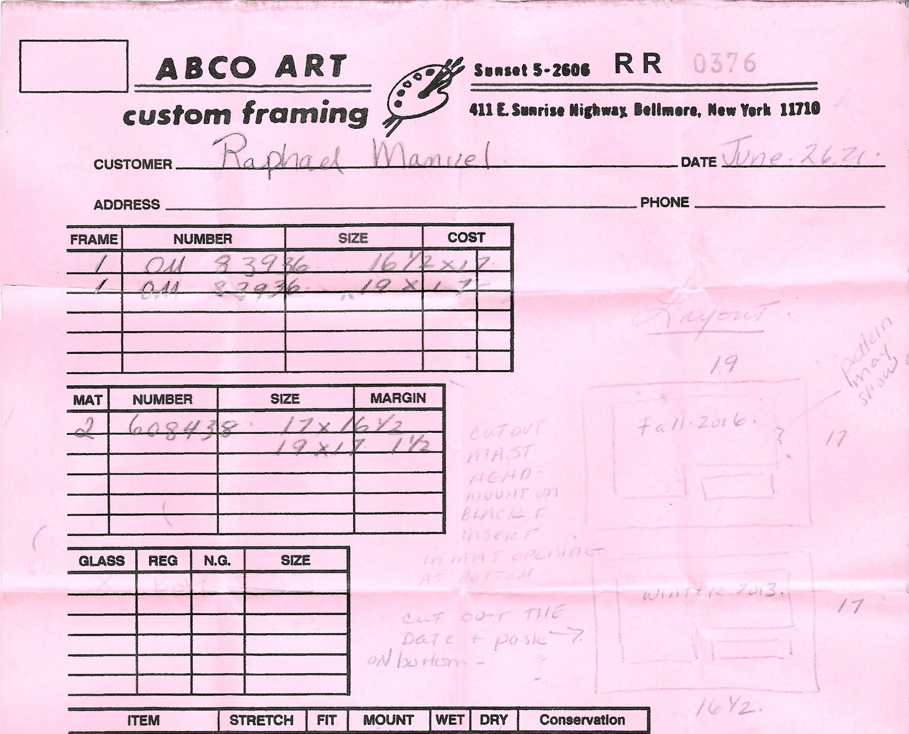
Orders
Different handwritings can be difficult to interpret.
Mistakes from ordering the wrong frame or glass can easily become costly.
Bigger orders would have be written separately.

Slide 7

Frames and Matboards
There are over 500 frame and matboard samples.
Price changes are frequent and each sample has to be changed manually.

Slide 8
Data Strategy
The owner is very old-school and the business is her father’s legacy. As a result, she rarely makes any changes to the business.
Implementing anything knew would be a “bottom-up” approach. Most of the employees are younger and have no problem working with technology.
Because of the size of Abco Art it would be more beneficial to invest into a cloud service to store our data. Frames and inventory stock would be kept in excel sheets and accessed through Dropbox using Microsoft OneDrive.
Sales records and operating costs will also be collected using excel.
Eventually, a system will be put into place to connect the inventory spreadsheets and Sale spreadsheets via APIs.

Slide 9
Timeline
STAGE 01
Establish what data we want to collect.
Organize past files which will be scanned and transferred to the database.
Take inventory of all frames and matboards and include pricing information.
STAGE 03
All of Abco Art Inc. data should be stored within the cloud.
STAGE 02
Through the use of APIs design a system that can access inventory and pricing data.
STAGE 04
The system will also be used to handle new and old orders

